Slide 1

PREPARED BY
mrinmay
mrinmay.santra@gmail.com
A PROJECT MANAGEMENT TOOL

Slide 2
Mavenized Agenda
01
Maven Identity
02
Maven In Action
03
Who is POM?
04
Archetype and Skeleton
05
Dependency Resolver
06
Plugin Orientation
07
Multi Modules
08
Release Management
09
Walkthrough and Query
10
Thank You

Slide 3
Welcome!!
Please be interactive
Prerequisites
Introduction to the Java Stack
Basic Java and XML skills

Slide 4
Maven Identity
Insert the title of your subtitle Here
PREPARE
COMPILE
TEST
PACKAGE
TESTING
INSTALL
DEPLOY
generate-sources/generate-resources
Compile Source code
test
package
integration-test (pre and post)
install
deploy

Slide 5

Maven In Action
Neighbor defines address
PCF Webservice Env.
build
read
CF push
check maven repo
Development Env.
P
O
M
7
4
Maven Central Repo
1
get JARs
5
n
check local repo
get JARs
2
5
3
Local .m2 Folder
get JARs
6
4
update local repo
check remote repo
Private Remote Artifactory

Slide 6
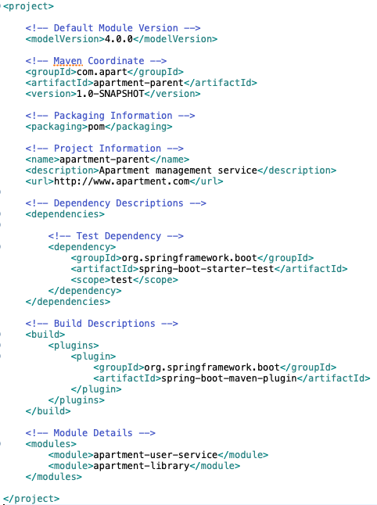
Who is POM?
POM stands for Project Object Model
Coordinate
Module
Project coordinate defines a unique identifier for the project.
Parent child dependency resolved as multi-module application.
Dependency
Maven internal caching mechanism and search engines are responsible to resolve dependency.
Other Info
Developer details and official site details.
Plugin
Internal plugin manager is responsible to resolve plugin dependency.

Slide 7
POM in Details
Neighbor defines address

Slide 8
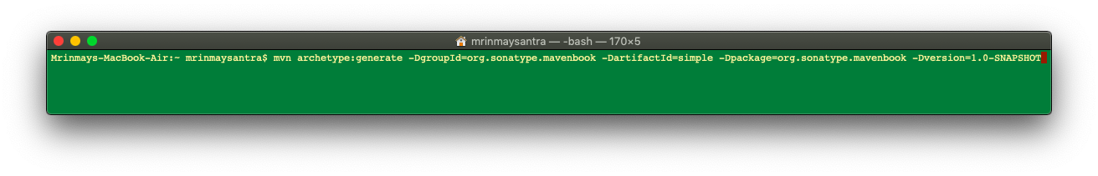
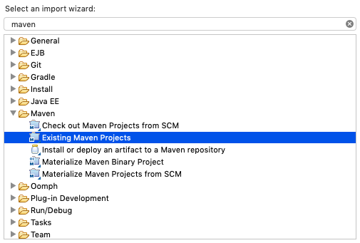
Archetype And Skeleton
Application skeleton creator
Create application - skeleton
The pom.xml and all subdirectories
Project Home
src
main
java
Java sourcecode for the project
resources
Deliverable resources for the project,
such as property files
test
Testing Java sourcecode for the project
java
resources
Resources necessary for testing
target
Import as Maven project
pom.xml

Slide 9
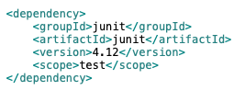
Dependency Resolver
Neighbor defines address
{groupId}/{artifactId}/{version}/{artifactId}-{version}.jar
pom.xml
read dependency
https://repo.maven.apache.org/maven/junit/junit/4.12/junit-4.12.jar
get JAR
get JAR
Maven Central Repo
${user.home}/.m2/repository/junit/junit/ 4.12/junit-4.12.jar
get JAR
‘.’ is replaced with ‘/’
{groupId}/{artifactId}/{version}/{artifactId}-{version}.jar
Local .m2 Repo

Slide 10
Transitive Dependency
Neighbor defines address

Slide 11
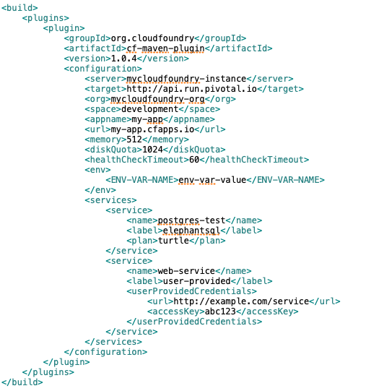
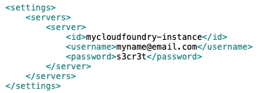
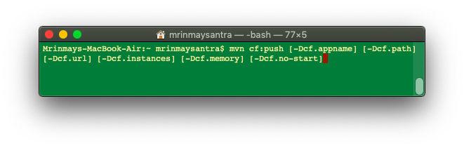
Plugin Orientation
Neighbor defines address
pom.xml
settings.xml
PCF Webservice Env.
Local Configuration
Need to update pom.xml with PCF plugin. For PCF WS credential settings.xml needs to update accordingly
Dependency s class-path JAR to develop task.
Plugin is JAR to run developed Task.

Slide 12
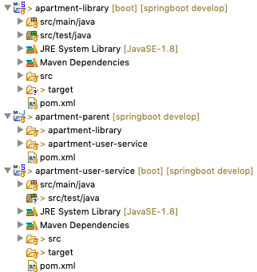
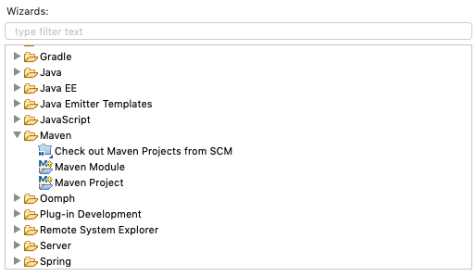
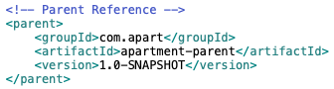
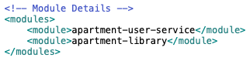
Multi Module
Neighbor defines address
Parent is normal Maven Project with package type is POM
Child is Maven module with parent details
Parent is centralized control of the app.

Slide 13
Release Management
Neighbor defines address

Slide 14
Maven Commands
Neighbor defines address

Slide 15
Maven Site
Neighbor defines address

Slide 16
Walkthrough and Query
Neighbor defines address
Reverse Domain
Maven developed in Java
Active MQ is written in Maven

Slide 17
Thank you
Feel free to connect
9836038333
mrinmay.santra@gmail.com

